Slide 1



Problem Resolution Management /
Defect Management

Slide 2

Creating a Defect (Create an Item)

Slide 3
Prerequisite and References
Users must have login access for Defect.
Users must have attended the “Basic Integrity Training”.
User should have a idea of following Integrity Terms:
  Login
  View-Sets
  Create Document / Item

Slide 4
Roles & Responsibility
ROLES | RESPONSIBILITY
Created By | Created by is the user who create the Defect in system. Anybody can create the defect.
Defect Resolution Team | Defect Resolution Team consist person/users, which are defined as Defect Resolution Team in Project Team Tab
Assigned User | Assigned user is assigned by Defect Resolution Team, who works on defect to resolve.
Assigned Reviewer | Assigned Reviewer is assigned by assigned user for defect review.
Assigned Tester | Assigned Tester is assigned by assigned user for defect testing
Responsible Person | Responsible Person is the person, who look after defect if Immediate counter-measure if YES.

Slide 5
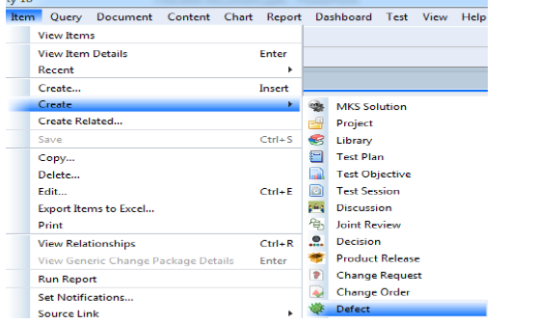
Creating and Managing Defect
Select Create in Item menu to create a new item in Integrity.
Steps:
1.Creating Defect Item
2.Editing data in Item view
3.Applying changes in created document

Slide 6
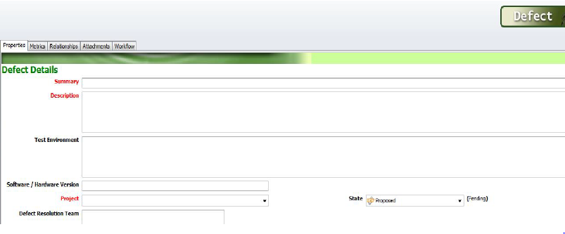
Creating and Managing Defect
Item view will open up. Enter or select correct values for the fields present.
Fields like Summary, Description etc .marked red are mandatory fields and must be filled.
Select appropriate field values (one or multiple) for multi-select fields.
Steps:
1.Creating Defect Item
2.Editing data in Item view
3.Applying changes in created document

Slide 7
Creating and Managing Defect
All other fields visible in the Item view must be filled.
Field edit ability depends upon Defect workflow LC state, depending on the state of the item it is in. Fields become editable or non editable
Clicking on “Apply” will keep the user on item edit view (user can still update fields) while clicking on “OK” will open item non-editable view (user can not update item fields)
Clicking “Apply” will save the Item. Alternately “Ctrl + S” can also be used.
Steps:
1.Creating Defect Item
2.Editing data in Item view
3.Applying changes in created document

Slide 8
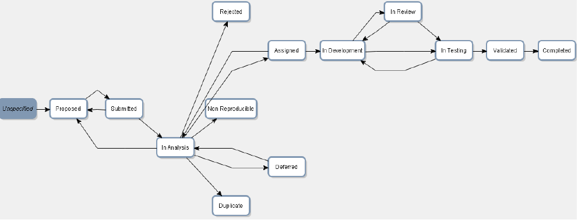
Defect Workflow
Defect workflow with life-cycle (see diagram below).
Defect Workflow help Defect state transition from one “state” to next “state” based on completion of activities as per system designed.

Slide 9
Explanation of Tabs and Sections

Slide 10
Different Tabs in Defect
TAB NAME | TAB USED FOR
Properties Tab | Properties contain all the necessary information, which need to be filled by different users on different stage to resolve defect.
Metrics Tab | Metrics tab is used for discovery of defect and mainly used by analysis team assigned for defect.
Relationship Tab | Relationship Tab contains all the related item/documents of defect
Attachment Tab | In attachment tab, user can attach external document like word/pdf/excel etc.
Test Result | Test Result tab contains Test cases through which defect was either passed or failed. This tab is mainly used by testing team.
Time Entries | This tab is used for timesheet entry.
Change Package | Change Package tab contains the information when defect used for change package creation.
Workflow | Workflow tab contains defect workflow.
History | History tab records all changes done by any user anywhere in defect

Slide 11
Properties Tab & Sections
The Properties tab contains sections, namely:
₋Defect Details
₋Defect Categorization
₋Defect Priotization
₋Defect Containment Requirement
₋Defect Analysis
₋Proposed Defect Resolution Approach

Slide 12
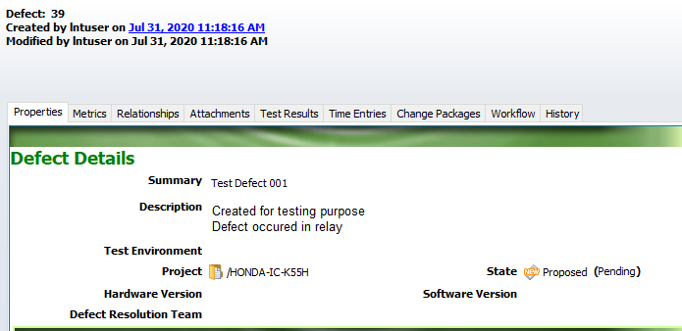
Properties Tab Explained: Defect Details (Section 1)
In Properties tab, Defect details section contain the information of occurred defect.

Slide 13
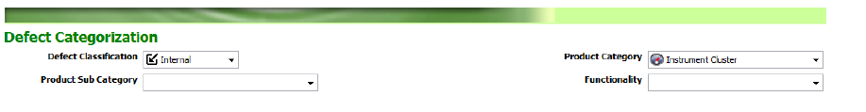
Properties Tab Explained: Defect Categorization (Section 2)
In Properties tab, Defect categorization section categorize the defect occurred.

Slide 14
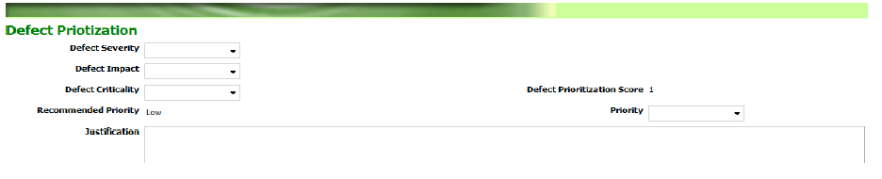
Properties Tab : Defect Priotization (Section 3)
In Properties tab, Defect Priotization section define the seriousness or urgency of defect on the basis of different attributes.
Recommended Priority is auto-calculated field, which measured on the basis of Defect Severity, Defect Impact, Defect Criticality etc.
NOTE: If Recommended Priority not equal to Priority, Justification is mandatory

Slide 15
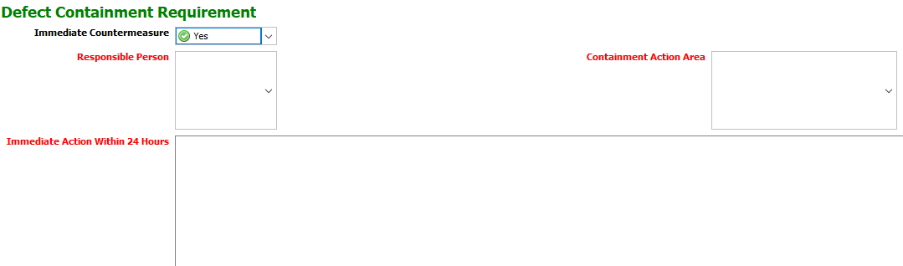
Properties Tab Explained: Defect Containment Requirement (Section 4)
In Properties tab, Defect Containment Requirement section define whether to take any immediate Countermeasure or not?
In below screenshot, there is Immediate Countermeasure field, which have two values : YES& NO
If user select YES all mandatory fields in below screenshot will appear and user need to fill it
If user select NO, not field will appear

Slide 16
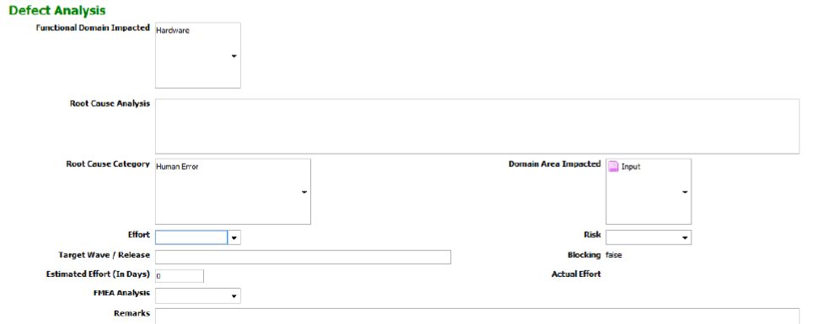
Properties Tab : Defect Analysis (Section 5)
In Properties tab, Defect Analysis section assigned team analysis the reason of defect occurred.
Defect Analysis section calculate the cause, efforts, impact etc. could be happen because of defect.

Slide 17
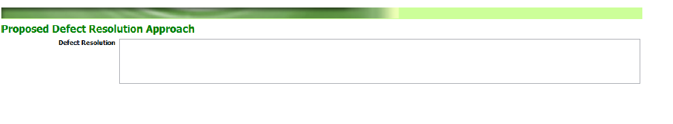
Properties Tab : Proposed Defect Resolution Approach(Section 6)
After analysis team analyze the defect occurred, proposed defect resolution could be filled in this section.
It is not a mandatory field, so user can leave it also but it is recommended to fill every information.

Slide 18
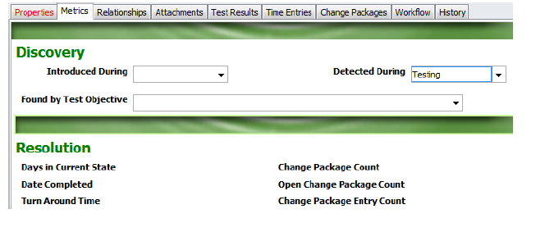
Metrics Tab & Sections
The Properties tab contains sections, namely:
-Discovery
-Resolution
Discovery section helps us to analyze the when defect introduced and when it is detected
Also in this section, we can mention test objective which was used at the time of testing
In resolution section, we can know about Days in current state, Date completed, Turn around time (Time from first to last state).
Also, all these fields are auto-calculated fields and values of these are automatically calculated at backend.

Slide 19
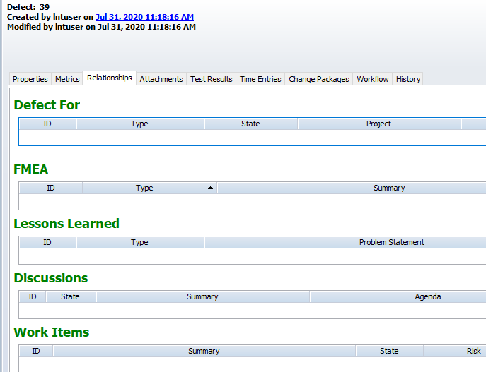
Relationships Tab
Relationship Tab of defects includes fields that are linked and inter-related to Defects itself.
The item for which the Defect Item is created should be attached in “Defect For” relationship field.
Lessons learned which we want to attach with existing defect should be attached in “Lessons Learned” relationship field.
Discussion which we want to attach with existing defect should be attached in “Discussions” relationship field.
Work Items which we want to attach with existing defect should be attached in “Work Items” relationship field.

Slide 20
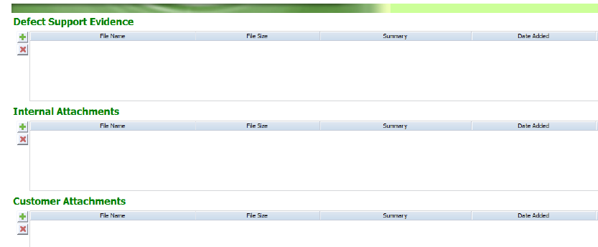
Attachments Tab
As the name suggests, any kind of file that is related to the Defect Item can be attached in this field.
The file could be a word document, pdf, jpeg, etc. that describes the Defect Item.
The Maximum file size that can be attached is 5 MB.

Slide 21
Explanation of workflow

Slide 22
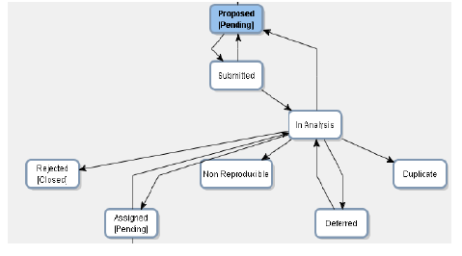
Defect Workflow Transition : Proposed State
When creator create a new defect, initially it is in “Proposed” state.
Only creator can transit the workflow from “Proposed” state to “submitted” state.
In Proposed state, Summary, Project and Description fields are mandatory which are marked by Red.

Slide 23
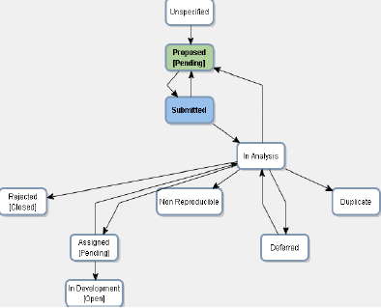
Defect Workflow Transition : Submitted State
After Proposed next state in Workflow is Submitted state
In Submitted state, Defect Resolution Team is Mandatory field, which is multi-valued field. Also, in attachment tab Defect Support Evidence attachment is mandatory.
Only Defect Resolution Team can transit the workflow from “Submitted” state to “Proposed and In Analysis state”.

Slide 24
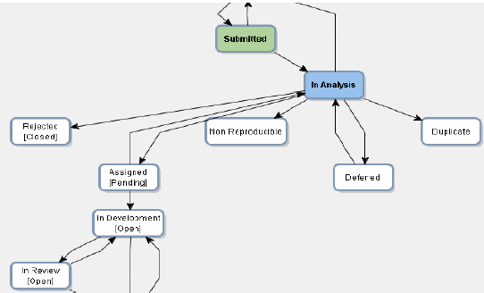
Defect Workflow Transition : In Analysis State
After Submitted next state in Workflow is In Analysis state
No new field is mandatory in this state.
In this state, analysis team analyze the defect and can transit workflow in desired state based on outcome of analysis.

Slide 25
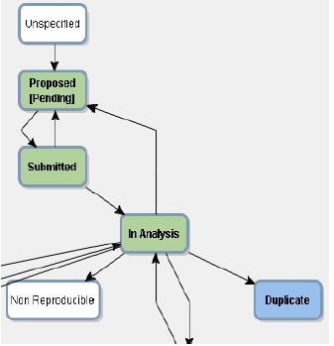
Defect Workflow Transition : Duplicate State
In Duplicate state, Remarks in Properties tab and Defects in relationship tab are mandatory fields.
User should set the state to Duplicate state, when same defect already present in system.

Slide 26
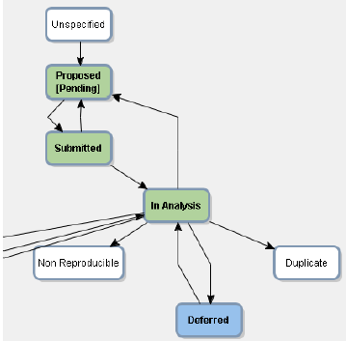
Defect Workflow Transition : Deferred State
In Deferred state, Deferred Till & Remarks in Properties tab is mandatory field.
We use deferred state when we have to park an item or document for later work
We can again go back to In Analysis state from Deferred state.

Slide 27
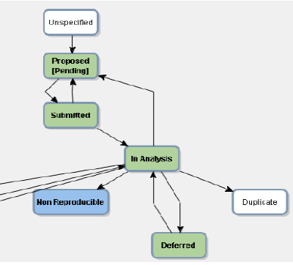
Defect Workflow Transition : Non-Reproducible State
In Non-Reproducible state, Remarks in Properties tab is mandatory field.
Provide the Details of Non –Reproducible conditions and its causes in the Remarks field.
Once Defect goes in Non –Reproducible state, its state cannot transit again.

Slide 28
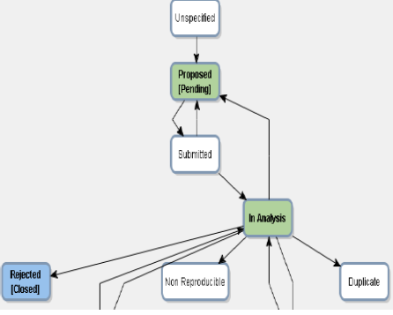
Defect Workflow Transition : Rejected State
In Rejected state, Remarks in Properties tab is mandatory field.
Provide the Details for rejecting the defect in Remarks field.
Once Defect goes in Rejected, its state cannot transit again.

Slide 29
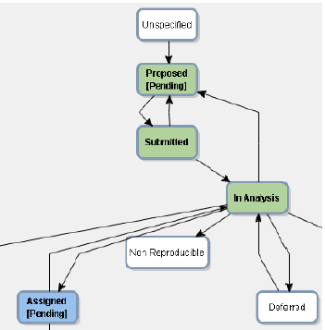
Defect Workflow Transition : Assigned State
In Assigned state, we analyses the defect and assign defect to assigned user.
Properties tab have various mandatory fields which need to be filled.
Only assigned user can transit the workflow from Assigned state to Development state or In Analysis state.

Slide 30
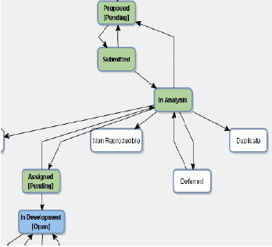
Defect Workflow Transition : In Development State
In In Development state, defect has been assigned to assigned user and in development state.
In development state, Defect resolution is mandatory field.
Only assigned user can transit the workflow from In development state to In Review or In testing state.

Slide 31
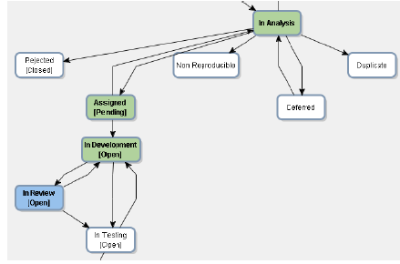
Defect Workflow Transition : In Review State
In In Review state, defect has been assigned to assigned reviewer for review process.
In review state, Assigned Reviewer is mandatory field.
Only Assigned Reviewer can transit the workflow from In Review state to In Development or In Testing state.

Slide 32
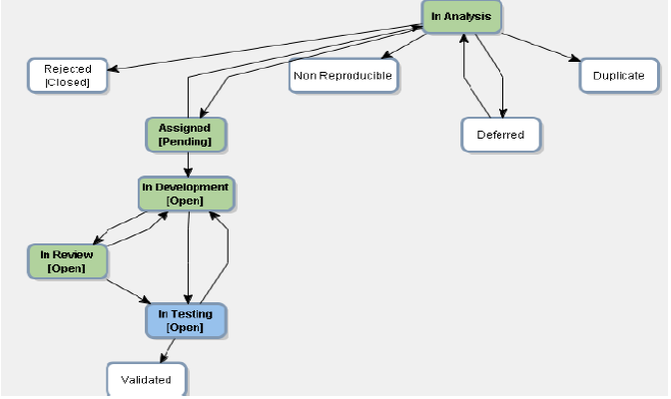
Defect Workflow Transition : In Testing State
In Testing state, defect has been assigned to assigned tester for Testing.
In Testing state, Mandatory field are Assigned Tester in properties tab, Introduced during, Detected during, Found by Test Objective in metrics tab.
Only Assigned Tester can transit the workflow from In Testing state to In Development or Validated state.

Slide 33
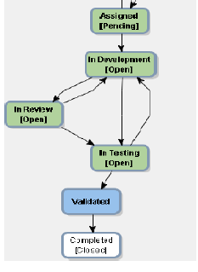
Defect Workflow Transition : Validated State
In Validated state, defect has been validated by defect Author
In validated state, no new field is mandatory
From Validated state, defect workflow can only transit in completed state.
Only Quality Assurance Engineer/ lead assigned for defect can transit the workflow from “Validated state ”to “ Completed state”

Slide 34
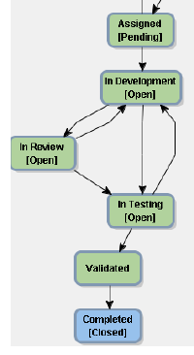
Defect Workflow Transition : Completed State
In Completed state, defect has been Analyzed, solved, tested, validated by every authorized person and finally moved to Completed state.
In completed state, no new field is mandatory
From Completed state, workflow of defect cant be transit in any other state.

Slide 35
Defect Reports

Slide 36
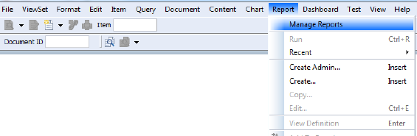
Defect Reports Explanation
Defect reports are used for Defect overview.
For accessing reports, go to Varroc user view set -> Reports -> Manage Reports -> Search Defect Reports in search bar -> select defect report.
As report opens in browser, through Item ID user can go to Defect in Integrity.
Reports in system are available according to different Queries like:
  -Defect in last 1 month
  -Defect in last 3 months
  -Defect in last 1 year
In similar way, report can be available as per user need.

Slide 37
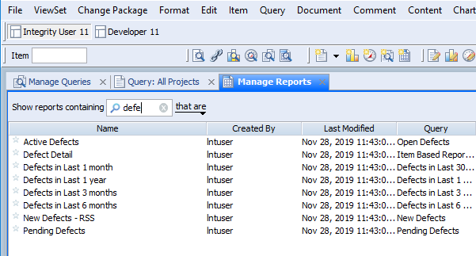
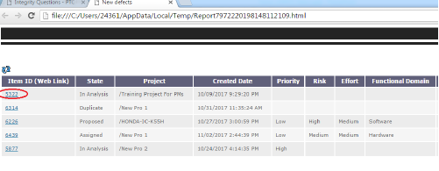
Defect Reports Explanation …Continued

Slide 38

Thank you
Thank you

